Slide 1
Mixed Integer Linear Programming with Python Package MIP
Jack Xue
2022-06-17

Slide 2
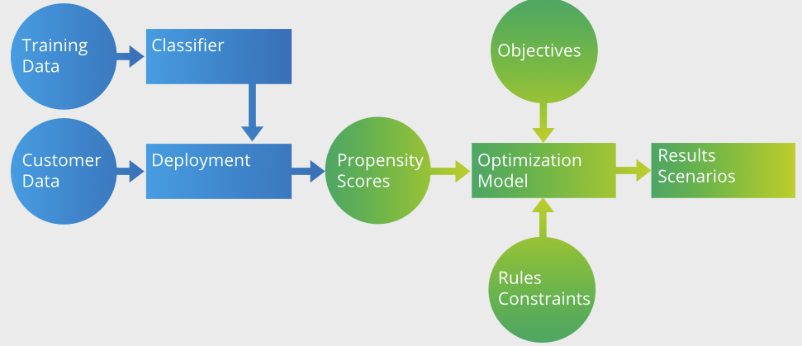
Problem Statement
An integer programming problem is a mathematical optimization in which all variables are restricted to be integers.
Integer programming is NP-complete
If some decision variables are not discrete the problem is known as a mixed-integer programming problem.

Slide 3
Existed Python Packages for LP
SciPy: Linear programming with solver
Pulp: Formularizer without solver and integration with commercial solvers, such as Gurobi
MIP: Mixed-Integer Linear Programming with solver and integration with commercial solvers, say Gurobi.

Slide 4
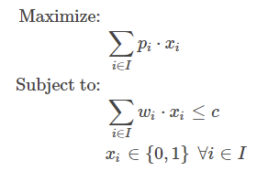
Example 1: The 0/1 Knapsack Problem
Given a set I of items, each one with a weight wi and estimated profit pi, one wants to select a subset with maximum profit such that the summation of the weights of the selected items is less or equal to the knapsack capacity c. Considering a set of decision binary variables xi that receive value 1 if the i-th item is selected, or 0 if not, the resulting mathematical programming formulation is:

Slide 5
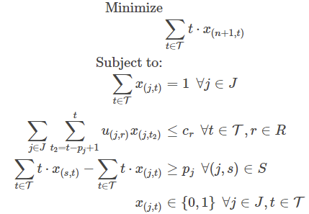
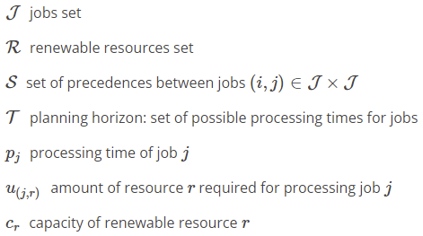
Example. 2: Resource Constrained Project Scheduling
The Resource-Constrained Project Scheduling Problem (RCPSP) is a combinatorial optimization problem that consists of finding a feasible scheduling for a set of n jobs subject to resource and precedence constraints.

Slide 6
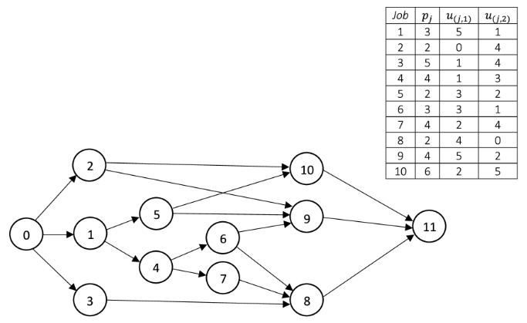
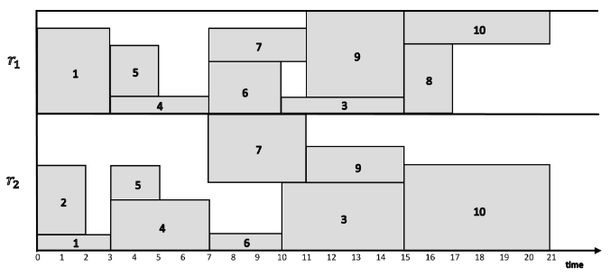
Example. 2: Resource Constrained Project Scheduling

Slide 7
Reference
Combining machine learning and mathematical optimization integration using Python (optimizationdirect.com)
Modeling Examples — Python-MIP documentation

